Slide 1

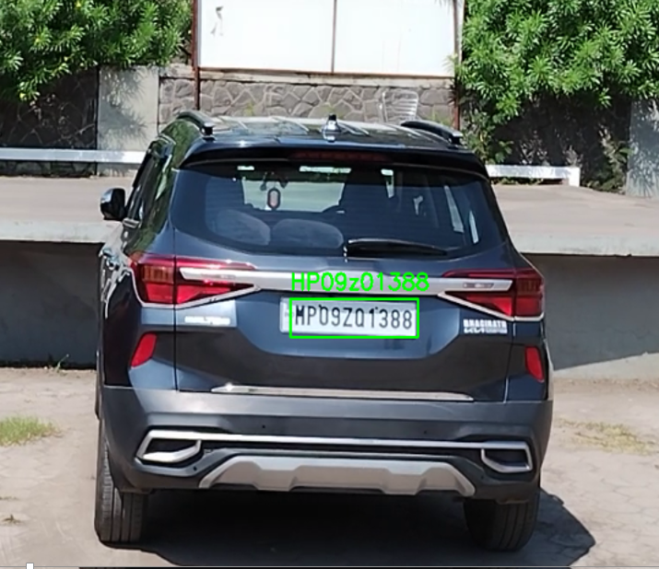
Prestige Institute of Engineering Management and Research, Indore (M.P)
Moving Vehicle Number Plate Detection

Slide 2





Team Mentors
Dr. Dipti Chauhan
Dr. Pritika Bahad
Team Members
Pukhraj Garasiya
Rohit Kumar
Deepak Singh

Slide 3
OBJECTIVE :
The objective of moving vehicle number plate detection is to develop a robust and efficient system capable of accurately identifying and capturing license plate information from vehicles in motion. This technology aims to enhance law enforcement, traffic management, and security systems by automating the process of vehicle identification, enabling real-time monitoring, and facilitating rapid response to potential threats or violations on the road.

Slide 4
INTRODUCTION
Moving vehicle number plate detection is a cutting-edge technology designed to automatically identify and capture license plate information from vehicles in motion. Leveraging advanced image processing and machine learning algorithms, this system can accurately detect license plates in various lighting conditions, weather, and speeds. It serves a wide range of applications including law enforcement for traffic violation detection, toll collection, parking management, and vehicle tracking. By automating the process of plate recognition, it enhances efficiency, reduces manual labor, and improves overall security measures on roads. This technology represents a significant advancement in surveillance and monitoring systems, contributing to safer and more organized traffic management.

Slide 5
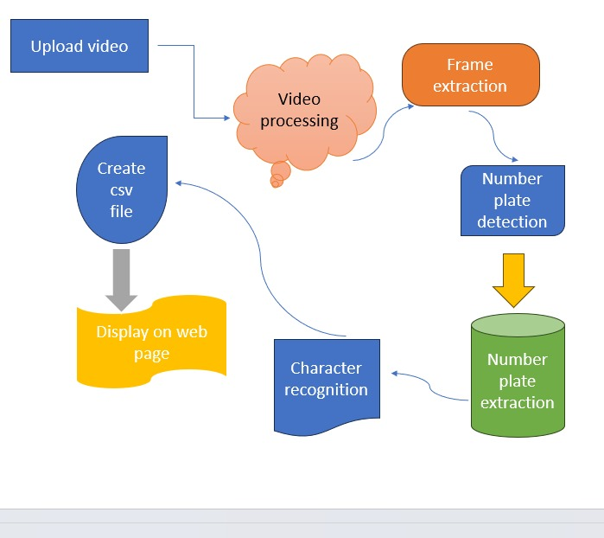
system diagram:

Slide 6





Technology
Open cv

Slide 7
Importance of Number Plate Detection
1
Enhanced Security
2
Traffic Management
Assists in law enforcement activities such as identifying stolen vehicles or suspects
Aids in monitoring and managing traffic flow and violations.

Slide 8
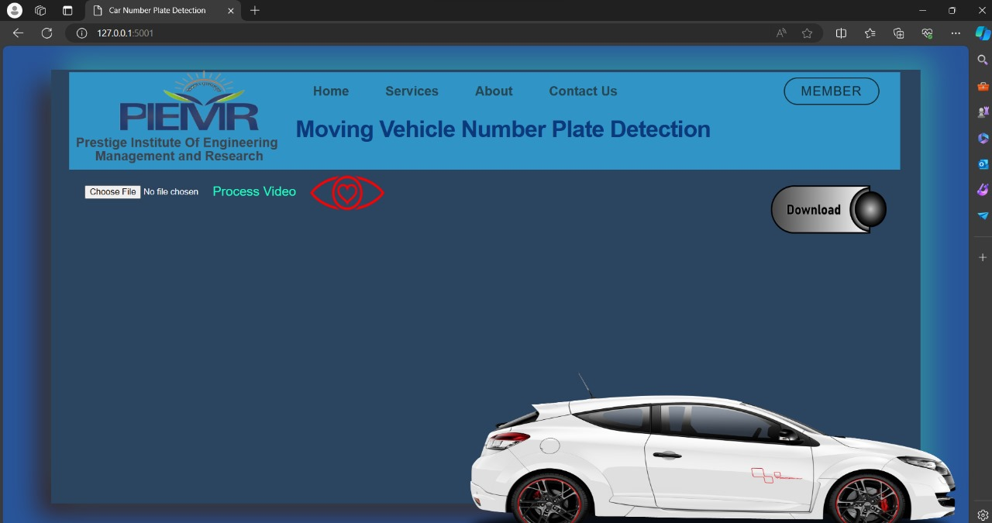
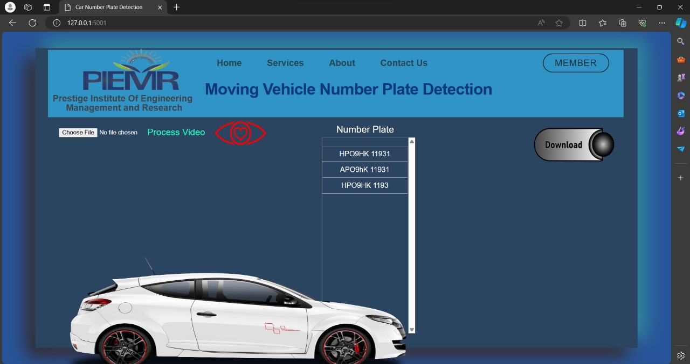
OUTPUT:

Slide 9
Applications
Intelligent Transportation Systems (ITS)
Security systems
Motorway toll collection (highway toll collection)
Traffic analysis
Police law enforcement
State border control
Enforcement of traffic regulations,
Vehicle theft prevention
Automation and simplification of airport,
Security monitoring of roads and checkpoints
Vehicle surveillance

Slide 10
Refrences

